Slide 1
Network Design(COIT20264)
ASSESSMENT 1 - GROUP PRESENTATION
Submitted To:
YouTube Video Link - https://www.youtube.com/watch?v=AOMDC9rZ6CM
1

Slide 2
Business Goals and Constraints
Increase the yield of SF member farmers to sell the harvest directly to the customer.
Sell the crops at a lower price compared to giant supermarkets in the state.
Allow customers to place an order through the web or application.
Store large numbers of products in the database and setting the delivery time for each order.
A separate application for farmers and customers. Truck drivers have an automated delivery process that is connected to the SF and Farmers.
Allow farmers to order the needs of farms through the network system.
Implementing automated plant data gathering by using IoT.
Include a discussion page on the web to allow farmers to ask a question. (Openheimer, P.et al(2011).
2

Slide 3
Technical Goals and Trade-offs
Make the web server available for all the farmers to increase the capability of uploading the harvest of crops in the system.
Collect real-time prices of crops in supermarkets to provide lower prices on the produce.
Increase network capability to collect real-time information about the plants and also increase network availability to allow the system to run the rest of the day to allow users to access the app and website anytime.
Increase data storage to store a large numbers of products and users in the system.
Increase bandwidth to allow bank access for farmers.
Increase the web and app availability and manageability for customers to easily navigate.
Install security programs on the server to prevent cybercriminal access and to help protect farmers’ and customers’ details. (Openheimer, P.et al(2011).
3

Slide 4
Technical Goals and Trade-offs
Providing the trade-offs for an organization will come with a big cost to providing good-performing materials for the system (Openheimer, P.et al(2011). The parameters that are crucial for the new system are those measured below in the trade-offs for Smart Farmers.
Network Performance | 35
Security | 35
Availability | 20
Total | 100%
4

Slide 5

Tables of User Communities, Data Stores, Network Applications and Traffic Flows

Slide 6
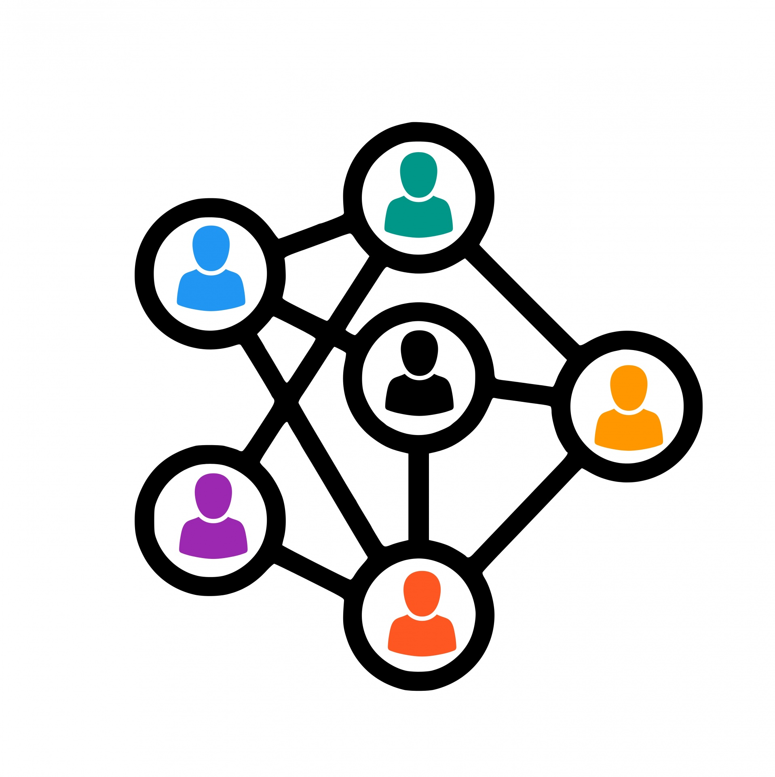
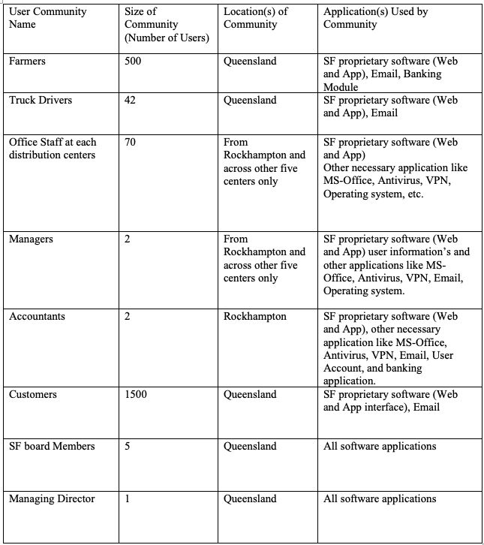
User Communities
(Geier, 2015)

Slide 7
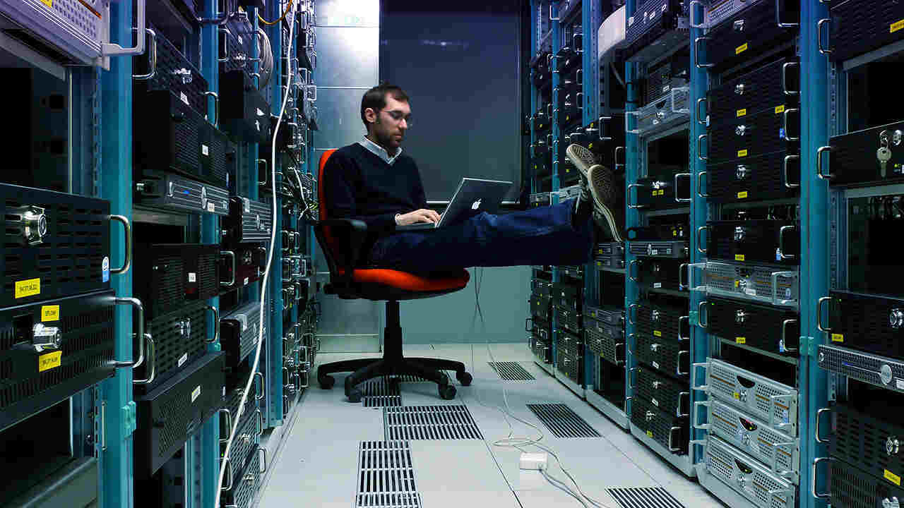
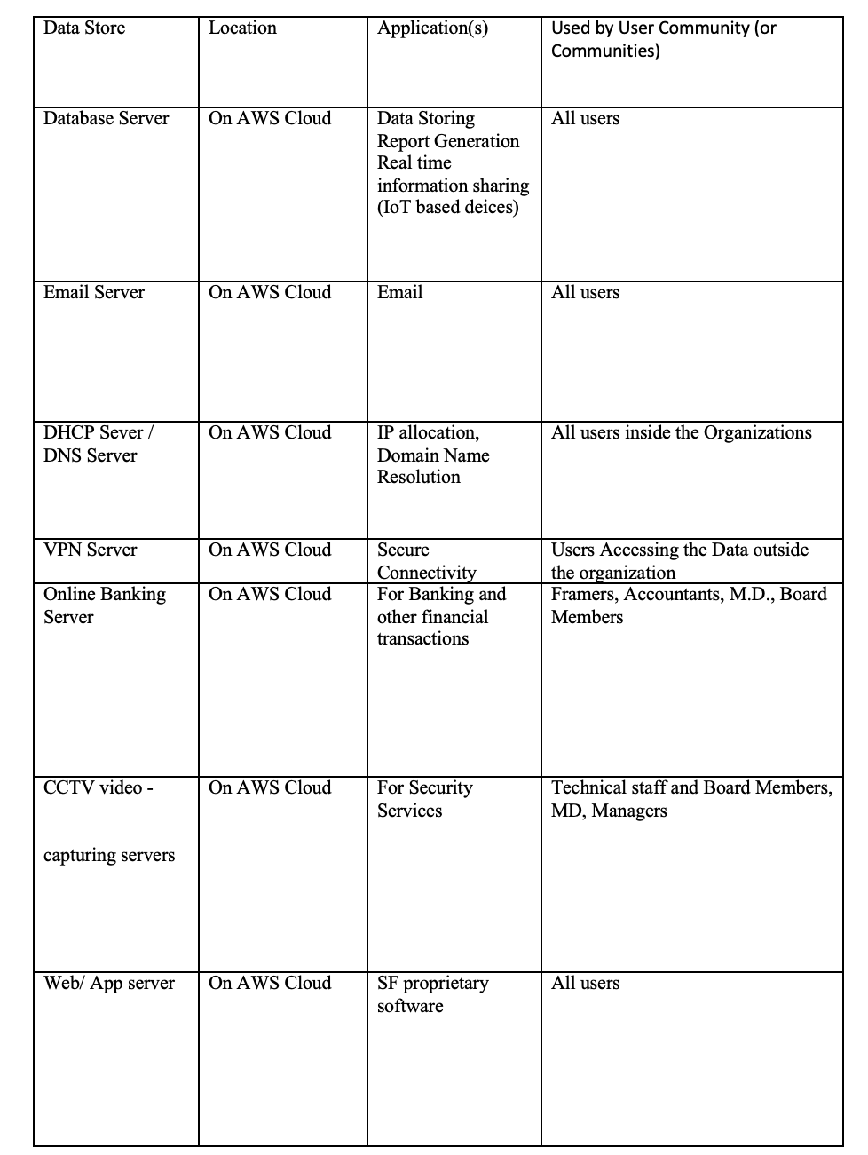
Data Source

Slide 8
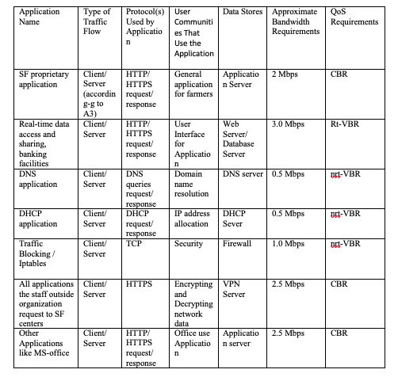
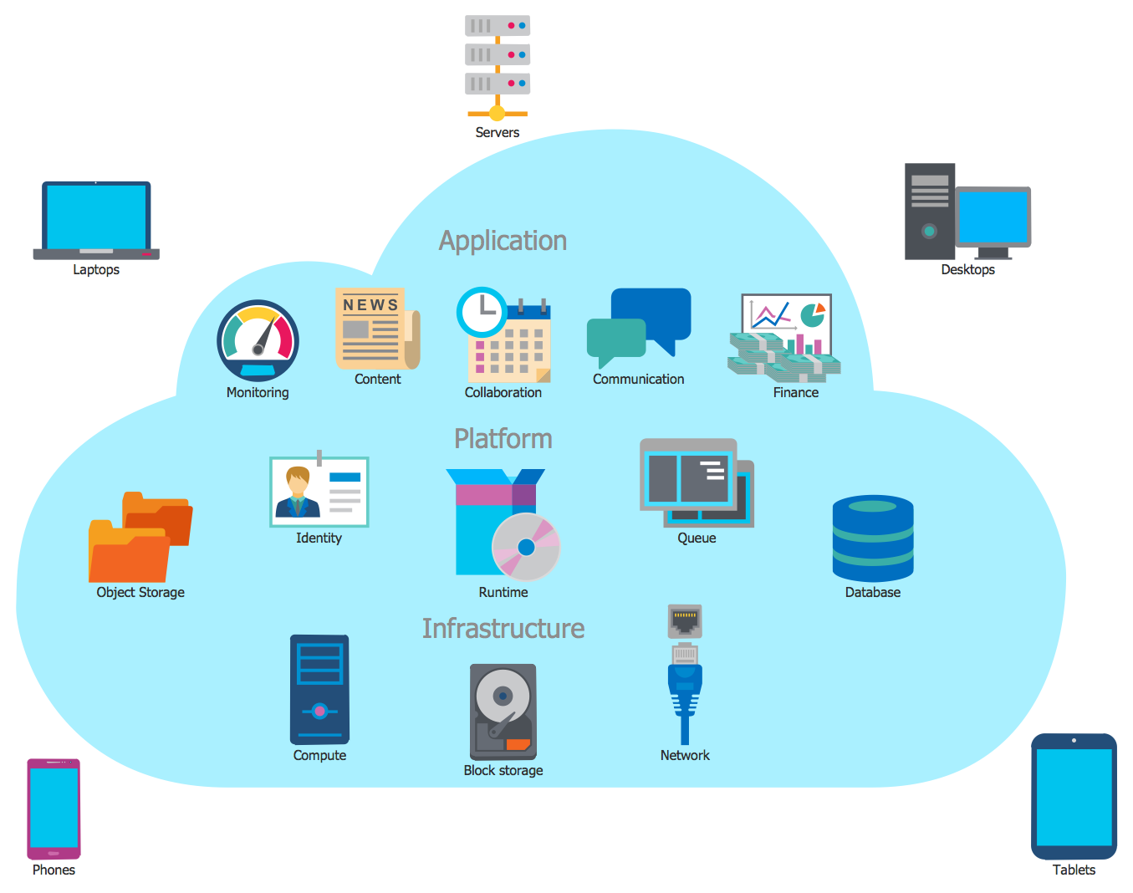
Network Application and Traffic Flow (Geier, 2015))

Slide 9
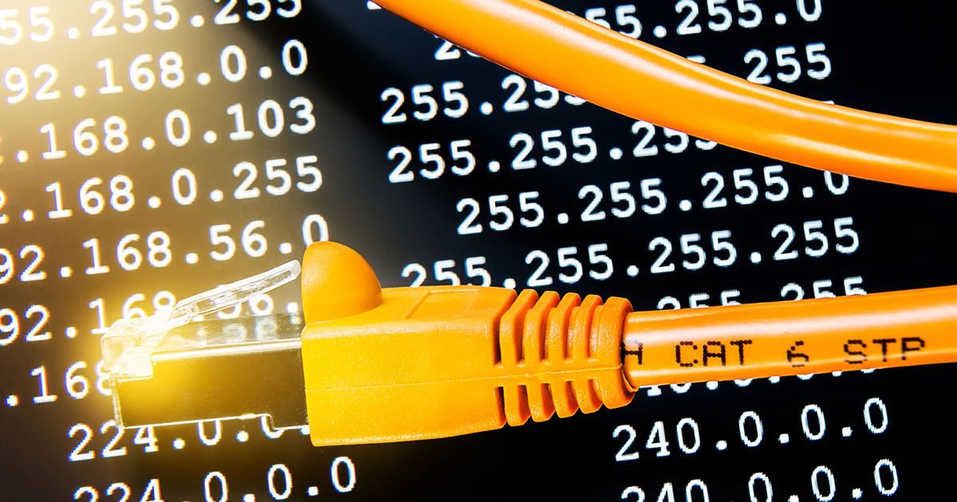
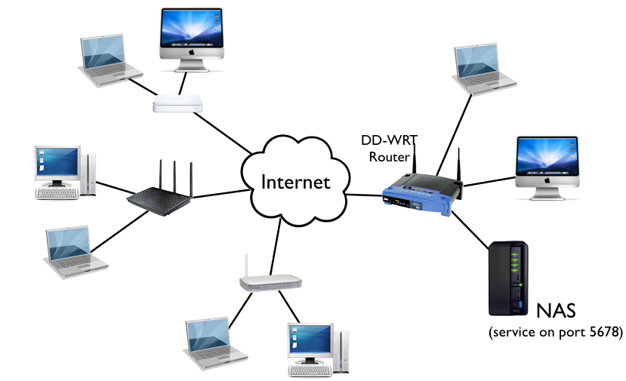
Network Diagrams Design with IP addressing subnetting
The Rockhampton office’s network design is very important as the high-speed internet lines with high bandwidth ensures that all the connected devices in the office including the servers are available for the smooth business operations (Geier, 2015). .
9

Slide 10

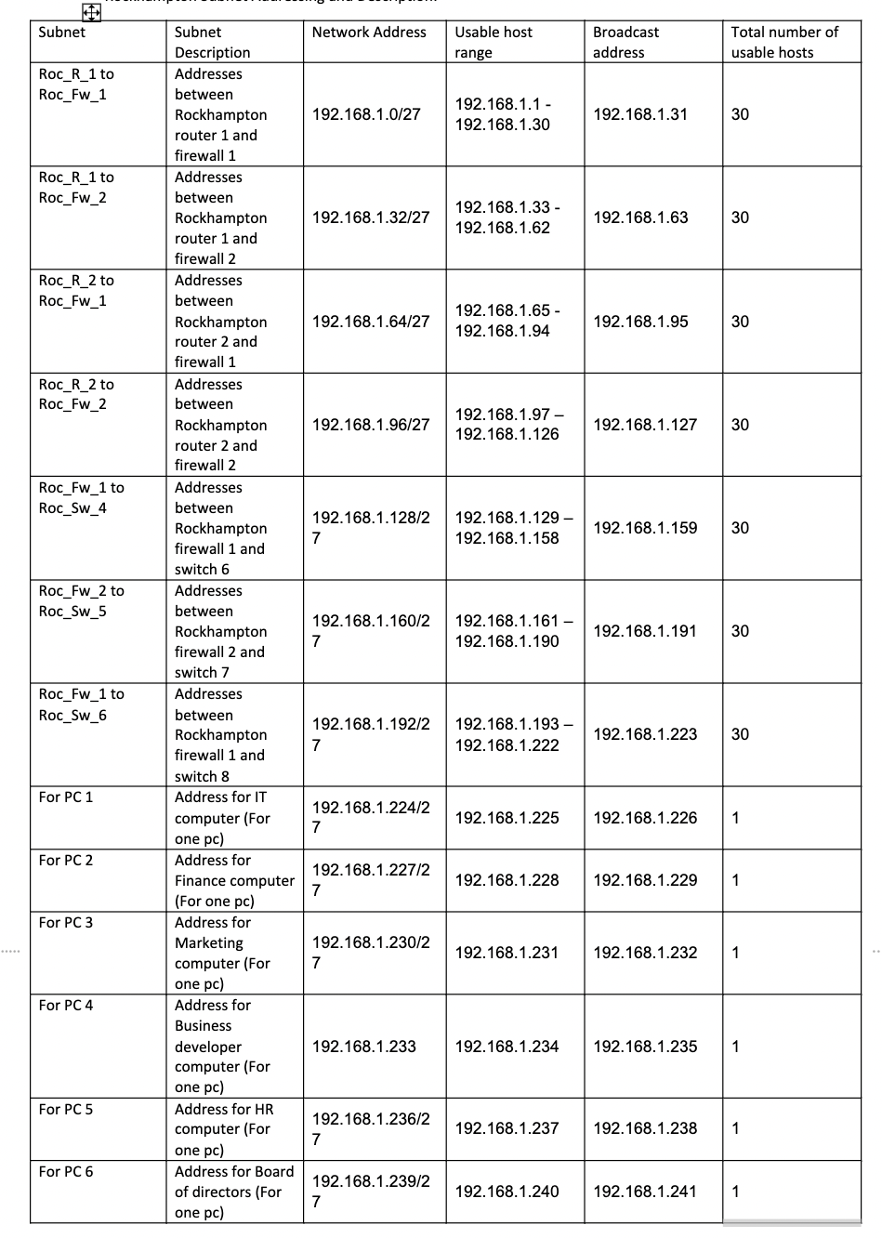
Network Diagrams Design with IP addressing subnetting
10

Slide 11
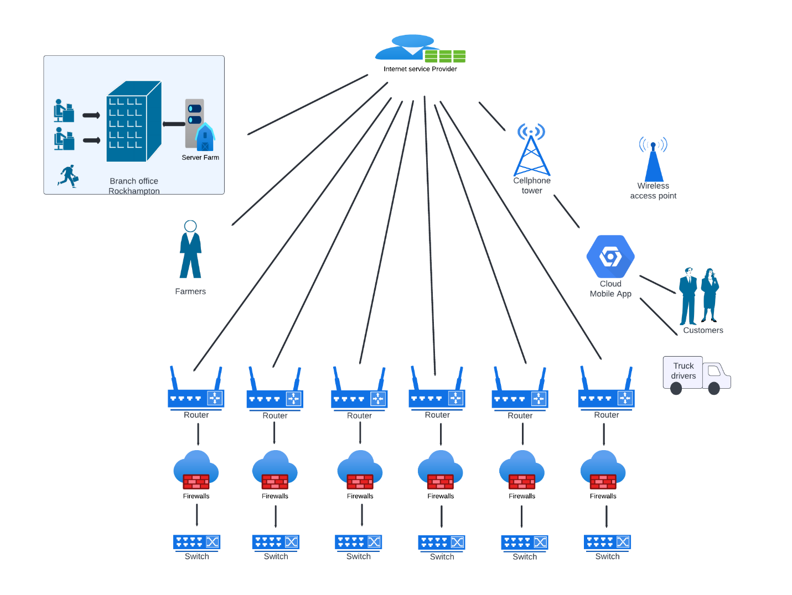
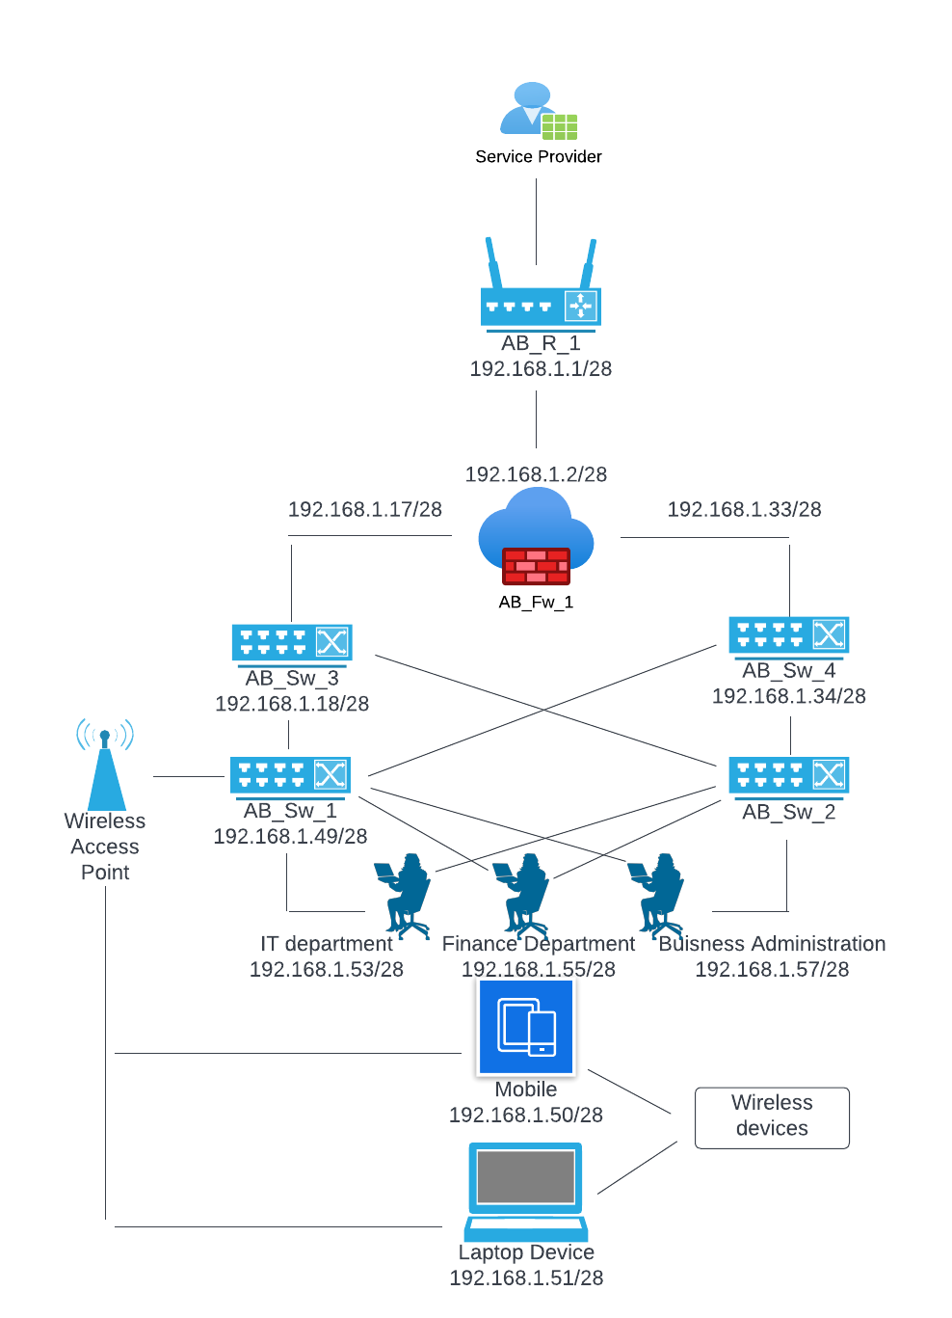
Smart Farmers Overall Network Diagram
Network Management Architecture
Top-down Network Design
11

Slide 12
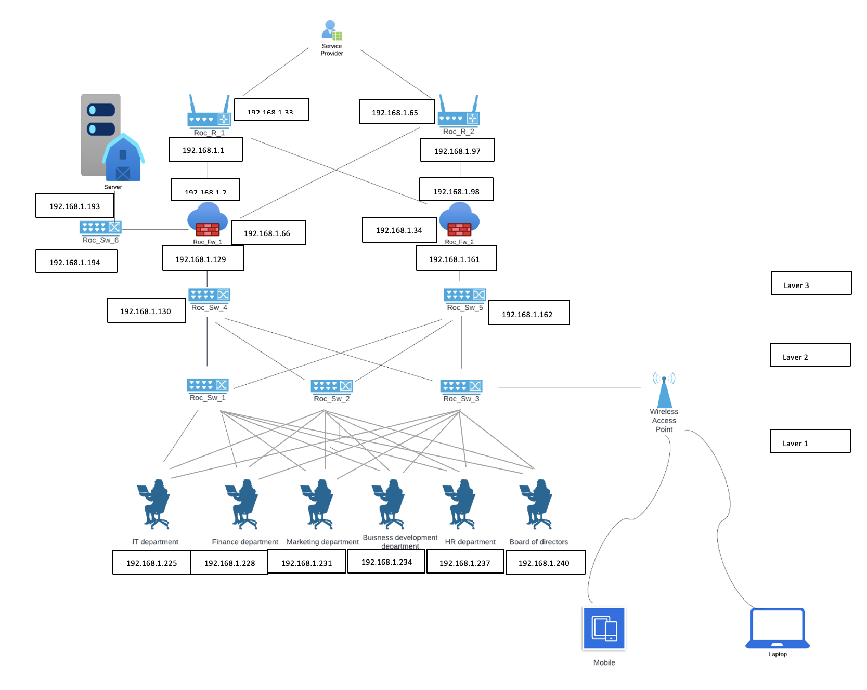
Network Diagrams Design with IP addressing subnetting
12

Slide 13
Routing Protocol
A computer network consists of nodes and routers along with other components.
Routing protocol describes how routers communicate with each other to transfer data from one node to another and also select the best route available. Routing protocol makes sure efficiency in computer network.
Smart farmers (SF) require customer, farmers, delivery trucks, distribution centres, and distribution vehicles to communicate their requirements such as placing order, various activities in the agricultural field etc. to a small office in Rockhampton.
For the given scenario, the most suitable routing protocol would be EIGRP (Enhanced Interior Gateway Protocol).
The main reason behind choosing this routing protocol is that only required information would be shared instead of sending the entire information to other routers present in the network. This ensures time is saved and workload is reduced along with reduction in amount of data being transmitted.
13

Slide 14
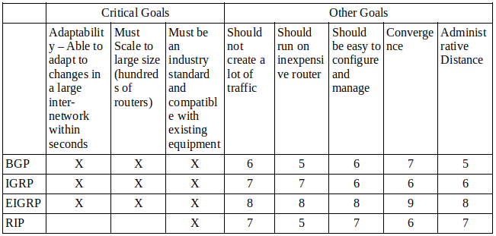
Routing Protocol

Slide 15
Switching Protocol
SF network include MQTT which is standard publish / subscribe protocol and is used for and is supported by connected devices.
The protocol is also used for machine-to-machine interactions.
In general cloud IoT core will be used which will support two protocols for device-to-device connection and communication – one being MQTT and other being HTTP.
HTTP is a connection less protocol which sends requests and receive responses.
To reduce the SF’s looping issues, Spanning Tree Protocol (STP) is used.
STP enables higher performance and allows the network to use backup connections when some interruption occurs.

Slide 16
Security Mechanisms
A network is vulnerable to attacks and hence require strong security to protect itself.
Encrypted: Sending data across the network in an encrypted form. This ensures confidential data is not compromised. Specially passwords that will be stored in the database and the passwords that will be used to login to the system will be encrypted and communicated through the network.
Digital Signature: Digital signature verifies data sent from a device in a network is authentic. This would also ensure that data was not tempered when travelling from one node to another.
Access Control: Having a good access control allows the organisation to ensure that only authorised people have access to the network and no attacker can break into the system. The server placed at Rockhampton must be accessible only to the server admin. The server shouldn’t be accessible by anyone else, and it must be password protected.
Traffic Padding: This process involves adding bits into gaps in an information flow so that traffic analysis attempts are stopped.
Routing Control: This process involves choosing secure routers for transfer of important data and regularly updates routing protocols in case of security issues are found out.
Firewall: A good firewall must be setup to monitor the incoming and outgoing network traffic based on organisation’s security policies. This will protect the server from malicious attacks such as DDoS, etc.

Slide 17
Conclusion
The top-down cloud-based network designing approach is used here for designing a network for the Smart Farmer's Cooperative society and we have tried to satisfy all the requirements that are necessary and asked by the Chairperson of the Smart Farmer's Cooperative society. The Rockhampton office has a primary router is directly connected to the high-speed internet connection and all the other devices of all the members are connected to other Network devices accordingly. Furthermore, we tried to achieve high availability, security and network performance so that organization can operate and performs their operations in a successful manner.
17

Slide 18
References
Geier, J., 2015. Designing and deploying 802.11 wireless networks: a practical guide to implementing 802.11 n and 802.11 ac wireless networks for enterprise-based applications. Cisco Press.(https://cqu-a.alma.exlibrisgroup.com/leganto/readinglist/lists/10312133640003441?institute=61CQU_INST&auth=SAML)
Oppenheimer, P. (2011). Top-down network design. Indianapolis, Ind.: Cisco Press. ‌
18

Slide 19



19
This Photo by Unknown Author is licensed under CC BY-NC

